Slide 1
Recognition of tokens
Starting point is the language grammar to understand the tokens:
stmt -> if expr then stmt
| if expr then stmt else stmt
| Ɛ
expr -> term relop term
| term
term -> id
| number

Slide 2
Recognition of tokens (cont.)
The next step is to formalize the patterns:
digit -> [0-9]
Digits -> digit+
number -> digit(.digits)? (E[+-]? Digit)?
letter -> [A-Za-z_]
id -> letter (letter|digit)*
If -> if
Then -> then
Else -> else
Relop -> < | > | <= | >= | = | <>
We also need to handle whitespaces:
ws -> (blank | tab | newline)⁺

Slide 3
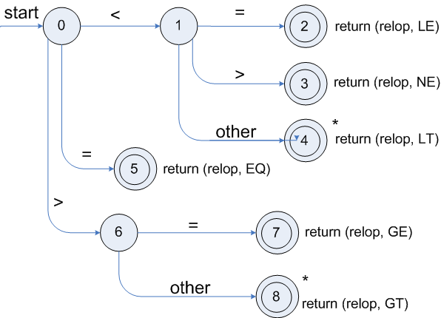
Transition diagrams
Transition diagram for relop

Slide 4
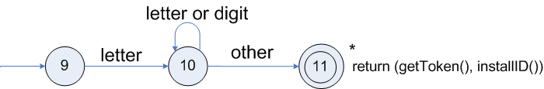
Transition diagrams (cont.)
Transition diagram for reserved words and identifiers

Slide 5
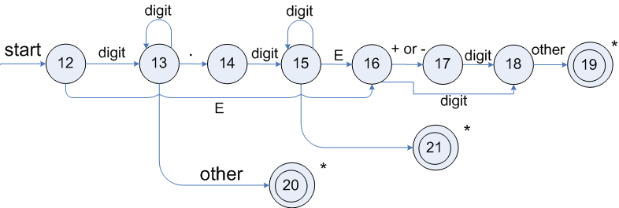
Transition diagrams (cont.)
Transition diagram for unsigned numbers

Slide 6
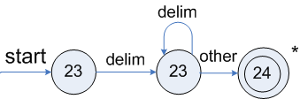
Transition diagrams (cont.)
Transition diagram for whitespace

Slide 7
Architecture of a transition-diagram-based lexical analyzer
TOKEN getRelop()
{
TOKEN retToken = new (RELOP)
while (1) { /* repeat character processing until a
return or failure occurs */
switch(state) {
case 0: c= nextchar();
if (c == ‘<‘) state = 1;
else if (c == ‘=‘) state = 5;
else if (c == ‘>’) state = 6;
else fail(); /* lexeme is not a relop */
break;
case 1: …
…
case 8: retract();
retToken.attribute = GT;
return(retToken);
}

Slide 8
Lexical Analyzer Generator - Lex
Lex Source program
lex.l
Lexical Compiler
lex.yy.c
C
compiler
lex.yy.c
a.out
a.out
Sequence of tokens
Input stream

Slide 9
Structure of Lex programs
declarations
%%
translation rules
%%
auxiliary functions
Pattern {Action}

Slide 10
Example
%{
/* definitions of manifest constants
LT, LE, EQ, NE, GT, GE,
IF, THEN, ELSE, ID, NUMBER, RELOP */
%}
/* regular definitions
delim [ \t\n]
ws {delim}+
letter [A-Za-z]
digit [0-9]
id {letter}({letter}|{digit})*
number {digit}+(\.{digit}+)?(E[+-]?{digit}+)?
%%
{ws} {/* no action and no return */}
if {return(IF);}
then {return(THEN);}
else {return(ELSE);}
{id} {yylval = (int) installID(); return(ID); }
{number} {yylval = (int) installNum(); return(NUMBER);}
…
Int installID() {/* funtion to install the lexeme, whose first character is pointed to by yytext, and whose length is yyleng, into the symbol table and return a pointer thereto */
}
Int installNum() { /* similar to installID, but puts numerical constants into a separate table */
}

Slide 11
Finite Automata
Regular expressions = specification
Finite automata = implementation
A finite automaton consists of
An input alphabet Σ
A set of states S
A start state n
A set of accepting states F ⊆ S
A set of transitions state →^{input} state

Slide 12
Finite Automata
Transition
s₁ →ª s₂
Is read
In state s₁ on input “a” go to state s₂
If end of input
If in accepting state => accept, othewise => reject
If no transition possible => reject

Slide 13
Finite Automata State Graphs
A state
The start state
An accepting state
a
A transition

Slide 14
A Simple Example
A finite automaton that accepts only “1”
A finite automaton accepts a string if we can follow transitions labeled with the characters in the string from the start to some accepting state
1

Slide 15
Another Simple Example
A finite automaton accepting any number of 1’s followed by a single 0
Alphabet: {0,1}
Check that “1110” is accepted but “110…” is not
1
0

Slide 16
And Another Example
Alphabet {0,1}
What language does this recognize?
1
0
0
0
1
1

Slide 17
And Another Example
Alphabet still { 0, 1 }
The operation of the automaton is not completely defined by the input
On input “11” the automaton could be in either state
1
1

Slide 18
Epsilon Moves
Another kind of transition: ε-moves
ε
A
B
Machine can move from state A to state B without reading input

Slide 19
Deterministic and Nondeterministic Automata
Deterministic Finite Automata (DFA)
One transition per input per state
No ε-moves
Nondeterministic Finite Automata (NFA)
Can have multiple transitions for one input in a given state
Can have ε-moves
Finite automata have finite memory
Need only to encode the current state

Slide 20
Execution of Finite Automata
A DFA can take only one path through the state graph
Completely determined by input
NFAs can choose
Whether to make ε-moves
Which of multiple transitions for a single input to take

Slide 21
Acceptance of NFAs
An NFA can get into multiple states
1
0
1
0
Input:
1
0
1
Rule: NFA accepts if it can get in a final state

Slide 22
NFA vs. DFA (1)
NFAs and DFAs recognize the same set of languages (regular languages)
DFAs are easier to implement
There are no choices to consider

Slide 23
NFA vs. DFA (2)
For a given language the NFA can be simpler than the DFA
1
0
0
NFA
0
1
0
0
0
DFA
1
1
DFA can be exponentially larger than NFA

Slide 24
Regular Expressions to Finite Automata
High-level sketch
NFA
Regular
expressions
DFA
Lexical
Specification
Table-driven
Implementation of DFA

Slide 25
Regular Expressions to NFA (1)
For each kind of rexp, define an NFA
Notation: NFA for rexp A
A
For ε
ε
For input a
a

Slide 26
Regular Expressions to NFA (2)
For AB
ε
A
B
For A | B
B
ε
ε
ε
ε
A

Slide 27
Regular Expressions to NFA (3)
For A*
ε
A
ε
ε

Slide 28
Example of RegExp -> NFA conversion
Consider the regular expression
(1 | 0)*1
The NFA is
ε
1
ε
ε
C
E
A
B
1
ε
0
G
H
ε
I
J
ε
D
F
ε
ε

Slide 29
Next
NFA
Regular
expressions
DFA
Lexical
Specification
Table-driven
Implementation of DFA

Slide 30
NFA to DFA. The Trick
Simulate the NFA
Each state of resulting DFA
= a non-empty subset of states of the NFA
Start state
= the set of NFA states reachable through ε-moves from NFA start state
Add a transition S →ª S’ to DFA iff
S’ is the set of NFA states reachable from the states in S after seeing the input a
considering ε-moves as well

Slide 31
NFA -> DFA Example
ε
1
ε
ε
C
E
A
B
1
ε
0
G
H
ε
I
J
ε
D
F
ε
ε
0
0
FGABCDHI
0
1
ABCDHI
1
1
EJGABCDHI

Slide 32
NFA to DFA. Remark
An NFA may be in many states at any time
How many different states ?
If there are N states, the NFA must be in some subset of those N states
How many non-empty subsets are there?
2^{N} - 1 = finitely many, but exponentially many

Slide 33
Implementation
A DFA can be implemented by a 2D table T
One dimension is “states”
Other dimension is “input symbols”
For every transition S_{i} →ª S_{k} define T[i,a] = k
DFA “execution”
If in state S_{i} and input a, read T[i,a] = k and skip to state S_{k}
Very efficient

Slide 34
Table Implementation of a DFA
0
0
T
0
1
S
1
1
U
 | 0 | 1
S | T | U
T | T | U
U | T | U

Slide 35
Implementation (Cont.)
NFA -> DFA conversion is at the heart of tools such as flex or jflex
But, DFAs can be huge
In practice, flex-like tools trade off speed for space in the choice of NFA and DFA representations

